Slide 1
Choices
Short and simple techniques to make life easier
Notes:
WELCOME
Choices – is the first in a series of POSITIVE BEHAVIOUR Bite Sized training resources designed to develop the positive behaviour management skills and knowledge of classroom teachers in schools, colleges and academies.
Other training in the POSITIVE BEHAVIOUR series include:
Raising the game – an introduction to positive behaviour management
More choices – Eight core principals for positive behaviour
Challenging behaviour – dealing with specific behaviour challenges
Dealing with difficult and challenging people
In order to facilitate today’s training, you will need:
Copies of the PowerPoint slides printed three to a page with space for notes for each participant
Copies of the accompanying ‘Choices’ handout for each participant
Flip chart paper and marker pens
All resources for this training are available to download from the SecEd website (add link) or by email from bitesizedtraining@gmx.com

Slide 2
Outcomes from today
By the end of this Bite Sized Training you will be able to:
Identify key positive behaviour techniques
Plan and implement positive behaviour strategies as part of your own classroom management strategy
Identify your own personal strengths and potential weaknesses in terms of positive behaviour management
Notes:
INTRODUCTION
Starting to lead will focus on positive behaviour strategies to make life easier in the classroom. By the end of this session, participants will be able to:
Identify key positive behaviour techniques
Plan and implement positive behaviour strategies as part of your own classroom management strategy
Identify your own personal strengths and potential weaknesses in terms of positive behaviour management

Slide 3
BEHAVIOUR ACTIVITY
As you explore each of the positive behaviour management strategies contained in this Bite Sized Training, think about:
What issue does this highlight in your own classroom practice?
What do you need to change to improve your learners’ behaviour?
How will this strategy help you do it.
Record your ideas on your Bite Sized Training handout.
Notes:
Behaviour Activity
As you explore each of the positive behaviour management strategies contained in this Bite Sized Training, think about:
What issue does this highlight in your own classroom practice?
What do you need to change to improve your learners’ behaviour?
How will this strategy help you do it.
Record your ideas on your Bite Sized Training handout.

Slide 4

1. Deliberately ignore
DON’T ignore difficult behaviour forever.
DO ignore things you can deal with later, better.
Notes:
1. Deliberately ignore
Imagine the scenario – you are explaining a key idea to your class when two students walk in 5 minutes late. What do you do – do you stop everything, lose the focus of the rest of the class and deal with the late arrivals? No – deliberately ignore. You are not going to ignore it forever, just until the time is right. Settle the latecomers down to their learning and then, later, go across and quietly find out WHY they are late and deal with it accordingly.
Don’t ignore difficult behaviour but do ignore things you can deal with later, better.

Slide 5
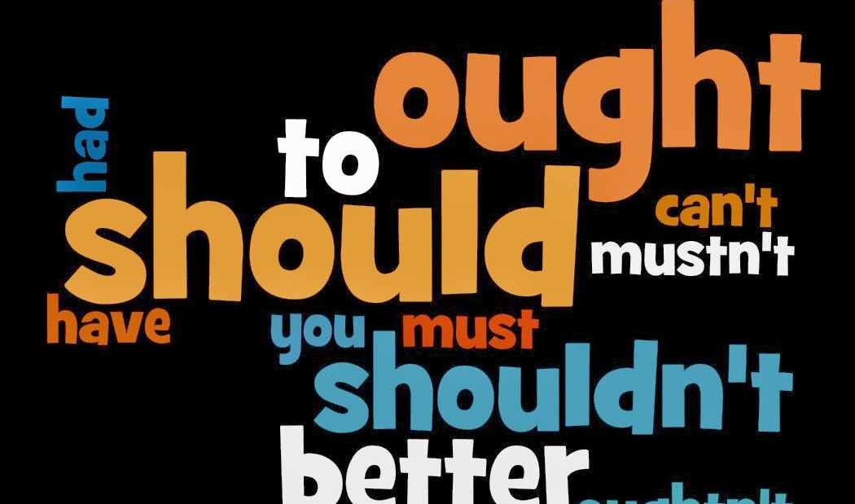
2. Give advice before warnings
Notes:
2. Give advice before warnings
Giving advice is a non-confrontational way of drawing a learner’s attention to the positive behaviour you want and expect. For example:
Stephen, if you shout other people down, they won’t want to listen to you
This tells Stephen the consequences of his action and, in a non-confrontational way, encourages him to stop shouting people down so that they will listen to him.

Slide 6
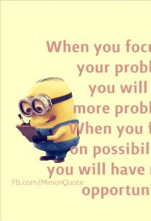
3. Focus on the key issue
Notes:
3. Focus on the key issue
What is the key issue for each and every one of your lessons? The learning and progress of your students.
Sometimes we get too focused on behaviour and punishment. Sanctions tend not to change behaviour but rewards do.
When you are managing learners’ behaviour, make your approach reward focused and get back to the key issue – students’ learning and progress – as quickly as possible.

Slide 7
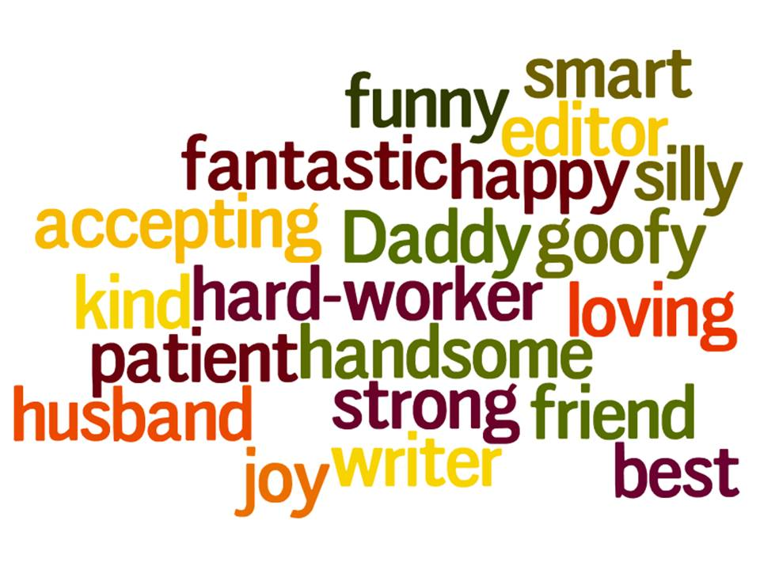
4. Use positive language
Notes:
4. Use positive language
Use do rather than don’t instructions with young people. Telling them what you want them to do is ALWAYS more effective than telling them what you want them to stop doing because the human brain finds it easier to respond to positives rather than negatives.
For example:
‘I need you to be quiet and listen’ is always better than ‘there’s too much talking in here’ since the first statement tells the student what the expected behaviour is. They know what you need them to do.
‘Why are you out of your seat?’ can’t be an effective instruction. Try ‘I need you to sit down now and get back to your learning’.

Slide 8

5. Make statements not questions
Notes:
5. Make statements not questions.
Never ask a question unless you want the answer:
‘What are you talking for?’ – You don’t want to know and you don’t care. What you mean is ‘I need you to stop talking and listen, thanks.’
‘Why haven’t you finished your work?’ Do you really want a load of pointless excuses. Of course not. Try ‘Let’s work together to get this exercise completed.’
‘What are you doing under the table?’ – Believe me, you just don’t want to know so don’t ask!

Slide 9

6. Use ‘Either …. Or … ‘ choices
Notes:
6. Use ‘Either …. Or … ‘ choices
Positive learner behaviour is all about choices. It is a sobering thought that you can’t make your students do anything they don’t want to do. All you can do is encourage them to make the choices – hopefully, the right choices. Be clear about the choices that your young people have in your space. Give a clear choice of either complying or receiving the agreed consequence.
For example:
‘Kerry, I have already asked you to put your hand up when you want to ask me something. Please make the right choice in future or I will just not respond to you.’

Slide 10
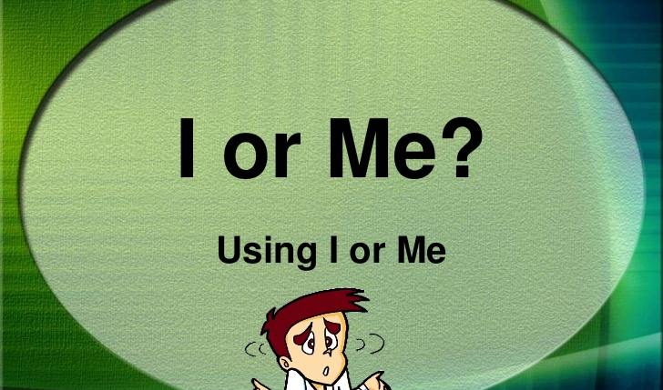
7. Use ‘I’
Notes:
7. Use ‘I’
Using ‘I’ takes the focus of the student’s behaviour away from them and focuses on the impact of that behaviour on you. This, again, is a non-confrontational way of suggesting a positive change in behaviour. So, how do we do it?
A brief description of the behaviour – ‘You keep talking when I am’.
The effect of this behaviour – ‘This means that you can’t hear me’
Your feelings – ‘I want you to do well’
The new desire behaviour – ‘Please be quiet and listen when I need to talk to you’.
For example
You arrived 15 minutes late for class
This means you have missed 15 minutes of your learning
I am disappointed that you a choosing not to learn
Be on time in future, thanks.

Slide 11

8. K.I.S.S.
(Keep it short and simple)
Notes:
8. K.I.S.S. (Keep it short and simple)
No one wants to be on the receiving end of a behaviour lecture and, remember, the focus of what we do in any classroom is learning and progress; so:
Focus on the key issue
Identify the problem
Resolve the problem
For example:
John, you haven’t done your homework. Without your homework you can’t complete this week’s work. You need to do your homework first and then arrange a time with me to catch up on today’s work.

Slide 12

9. Use only ONE formal warning
Notes:
9. Use only ONE formal warning
Many school behaviour policies require teachers to give three warnings. You could call this a ‘three strikes and you’re out’ policy. If this is your school policy, then, of course, you must follow it. However, here’s the reason it is a bad idea – Young people are programmed to push boundaries of behaviour. This is a good thing. However, if they know they will get three warnings before anything serious happens, they quickly learn that they can disrupt behaviour for three times as long before you do anything. How can three times as much disruption be good practice?
Do not use repeated formal warnings as it encourages young people to push the boundaries three times as far.

Slide 13

10. Allow for compliance time
Notes:
10. Allow for compliance time
Unless there is a risk of young people harming themselves or others, do not insist on instant compliance. Allowing a little time reduces confrontation and allows them to ‘save face’ in front of their peers.

Slide 14
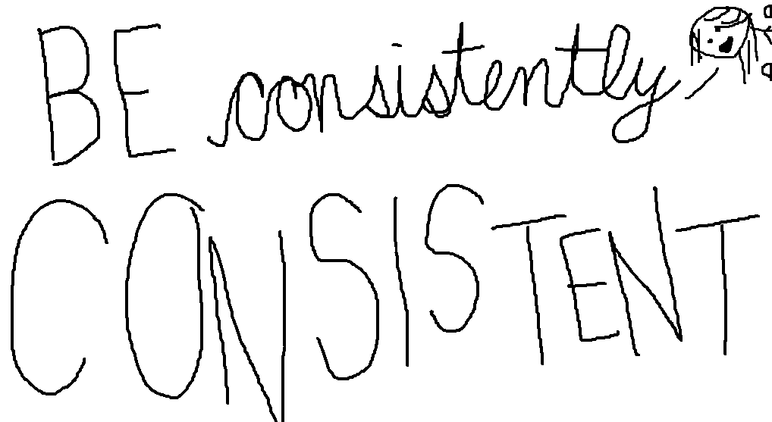
11. Be consistent
Notes:
11. Be consistent
It can be argued that this is the most important behaviour management strategy. Whatever you do, do it consistently so that the young people you teach know what is expected, know the rewards for doing what is asked, understand the sanctions if they choose not to comply with your clear instructions; and are able to accurately predict the positive behaviour your expect from them each and every time you see them.

Slide 15

Make it Work at Work
What are you going to DO as a result of this Bite Sized Training session?
Notes:
MAKING IT WORK AT WORK
ACTIVITY: What will you do as a result of this Bite Sized Training?
Working in groups, look at the action sheet you have produced during today’s training.
What are the three key learning points for you?
What will you change tomorrow to improve your positive behaviour management?
How will you know when your change has been successful?

Slide 16
Where next?
Choices – is the first in a series of POSITIVE BEHAVIOUR Bite Sized training resources designed to develop the positive behaviour management skills and knowledge of classroom teachers in schools, colleges and academies.
Other training in the POSITIVE BEHAVIOUR series include:
Raising the game – an introduction to positive behaviour management
More choices – Eight core principals for positive behaviour
Challenging behaviour – dealing with specific behaviour challenges
Dealing with difficult and challenging people
Bite Sized Training offers a wide range of school based CPD sessions designed to be used as sharply focused yet active training sessions of no more than 45 minutes in length. Bite Sized Training materials are produced by Steve Burnage through www.simplyinset.co.uk. Steve is an experienced author, trainer and education consultant with over 25 years experience of working in UK schools.
For details of other CPD offered through Bite Sized Training, email bitesizedtraining@gmx.com or call +44767 858360
Notes:
Choices – is the first in a series of POSITIVE BEHAVIOUR Bite Sized training resources designed to develop the positive behaviour management skills and knowledge of classroom teachers in schools, colleges and academies.
Other training in the POSITIVE BEHAVIOUR series include:
Raising the game – an introduction to positive behaviour management
More choices – Eight core principals for positive behaviour
Challenging behaviour – dealing with specific behaviour challenges
Dealing with difficult and challenging people
Bite Sized Training offers a wide range of school based CPD sessions designed to be used as sharply focused yet active training sessions of no more than 45 minutes in length. Bite Sized Training materials are produced by Steve Burnage through www.simplyinset.co.uk. Steve is an experienced author, trainer and education consultant with over 25 years experience of working in UK schools.
For details of other CPD offered through Bite Sized Training, email bitesizedtraining@gmx.com or call +44767 858360

