Slide 1


What is artificial intelligence (AI), how does it work, and how do we use it in our daily lives?
Notes:
Opening for Presentation:
Good morning, everyone! It’s wonderful to see so many of you here today.
Let me introduce myself – I’m Aimee Williams, Director of Education for the Three Spires Trust.
Now, I’m not claiming to have all the answers or a magic formula, but I do have plenty of experiences to draw from, and I’m happy to share them. I would also encourage you to be active participants in today’s session. Please feel free to drop your thoughts, ideas, and experiences in the chat throughout. After all, the real experts in this room are you.

Slide 2

Sketch what you think AI looks like?
Label any key features in your drawing
Do now

Slide 3

Artificial Intelligence is when machines or computers are made to think and learn like humans.
Instead of just following instructions, AI can look at information, learn from it, and then make decisions or help solve problems on its own.

Slide 4
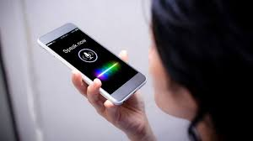



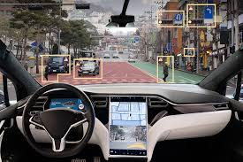
  Where have you seen AI before?
  How does it help us in daily life?

Slide 5
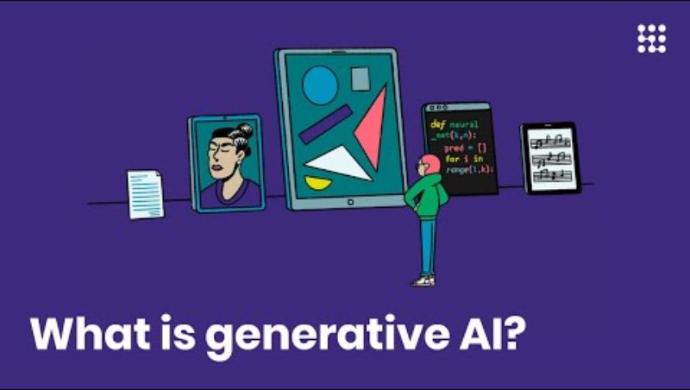

Slide 6
  The process
Input
The AI collects data (e.g.,
Processing
It learns patterns from
Output
It predicts or recommends something
voice, images, searches).
past data.

Slide 7


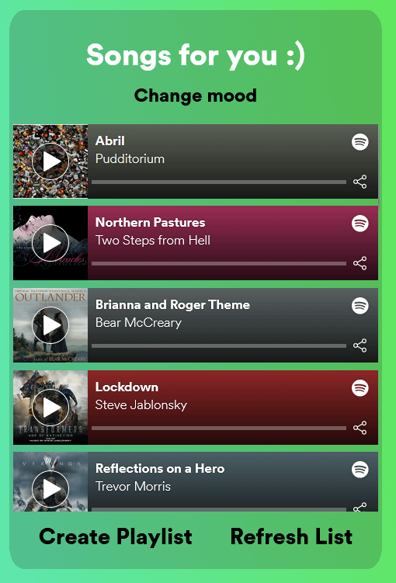
Input
Spotify collects data on the songs you listen to, how long you listen and whether you skip songs.
Processing
The AI analyses patterns in your listening habits and compares them with other users who have similar tastes.
Output
The app generates a personalised playlist and recommends new songs.
  Example

Slide 8
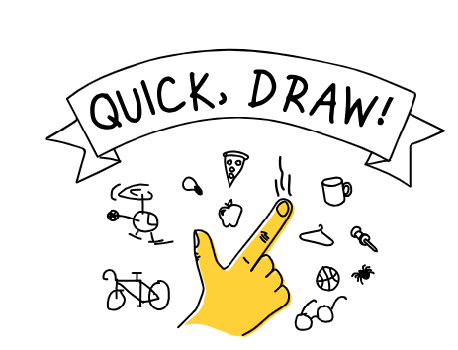
Quick draw
What do you think the AI was "learning" from the drawings?
How quickly did the AI start guessing accurately? What might have helped it guess better?

Slide 9
Write a short reflection on how AI learns patterns and makes predictions based on input (their drawings).
AI learns patterns by...
I noticed that the AI improved its guesses when...
The AI seemed to learn from...
I think the AI was able to make better guesses because...
It was interesting to see how the AI...
In the beginning, the AI... but later...
This activity showed me that AI...

Slide 10

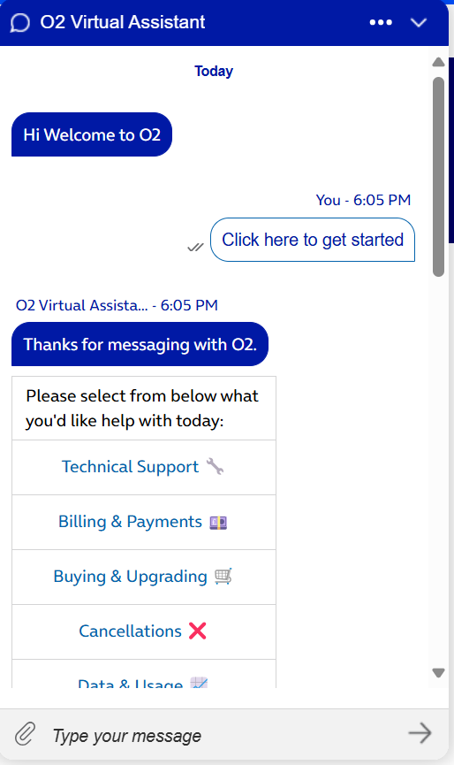
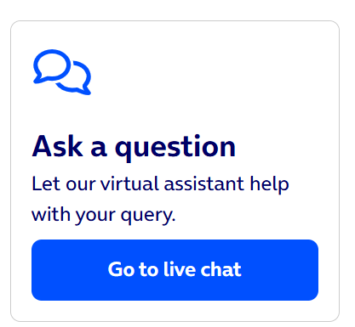
Quick draw
Key vocabulary
Misinformation
Privacy
Bias
Notes:
Misinformation:
False or inaccurate information that is spread, regardless of intent. Misinformation can be shared unintentionally, and people might believe or spread it without realizing it's incorrect.
Privacy:
The right to control one's personal information and keep it secure from unauthorized access. It involves the protection of data and personal details, ensuring they are used only in ways that an individual has agreed to or authorized.
Bias:
A tendency to favor or discriminate against a particular group, idea, or perspective in a way that is unfair or unjust. In AI, bias occurs when the algorithms or data used to train the system lead to decisions that reflect these imbalances or prejudices.

Slide 11
AI scenarios | How does it help? | Risk?
Customer service CHAT | Instant Support: Provides immediate assistance to visitors, reducing wait times compared to email or phone support. Convenience: Allows users to get help without leaving the website or waiting for an email response. 24/7 Availability: Can be integrated with automated bots to offer support even outside regular business hours. Cost-Effective: Reduces the need for a large customer service team by automating responses for common queries. | Privacy Concerns: When using live chat, you might need to share personal details like your email or phone number. If this information isn’t protected properly, it could get into the wrong hands. Data Security: Sometimes, conversations might have private or important information. If it’s not kept safe or protected, it could get lost or stolen. Misinformation: Sometimes, automated systems or robots might give wrong or old information if they’re not updated. This could confuse people or make the company look bad. Limited Understanding: Chatbots (robots) can have trouble understanding tough or tricky questions, which might lead to answers that don’t really help or make things worse.
AI moderating social media comments
AI in Healthcare Diagnostics
Notes:
AI moderating social media comments
Benefits
Speed: AI can quickly review and respond to inappropriate content, ensuring harmful posts are removed faster than human moderators could.
24/7 Monitoring: AI can work around the clock, providing continuous moderation without breaks, ensuring that harmful content is flagged at any time of day.
Scalability: AI can handle large volumes of content, making it easier to moderate millions of posts or comments across different platforms.
Reduced Human Bias: When trained properly, AI can be less biased than humans, ensuring that content is flagged or removed based on clear guidelines rather than personal opinion.
Cost-Effective: AI reduces the need for a large team of human moderators, saving companies money while still maintaining effective content control.
Support for Human Moderators: AI can help human moderators by filtering out obvious cases, allowing them to focus on more complex or borderline content that needs human judgment.
Risk
Privacy Concerns: AI may have access to sensitive user data, and if not properly protected, it could expose private information or be misused.
Dependence on Technology: Relying too heavily on AI could lead to a lack of human oversight, which is important for catching complex or borderline cases that AI might miss.
False Positives and Negatives: AI might incorrectly flag harmless content (false positives) or miss harmful content (false negatives), which can undermine trust in the platform.
Inability to Handle Complex Content: AI may struggle to moderate certain forms of content, like memes, which can carry subtle or evolving meanings that AI may not fully comprehend.

Slide 12
Plenary
What is AI?
Why is it important to understand how AI works?

